Slide 1
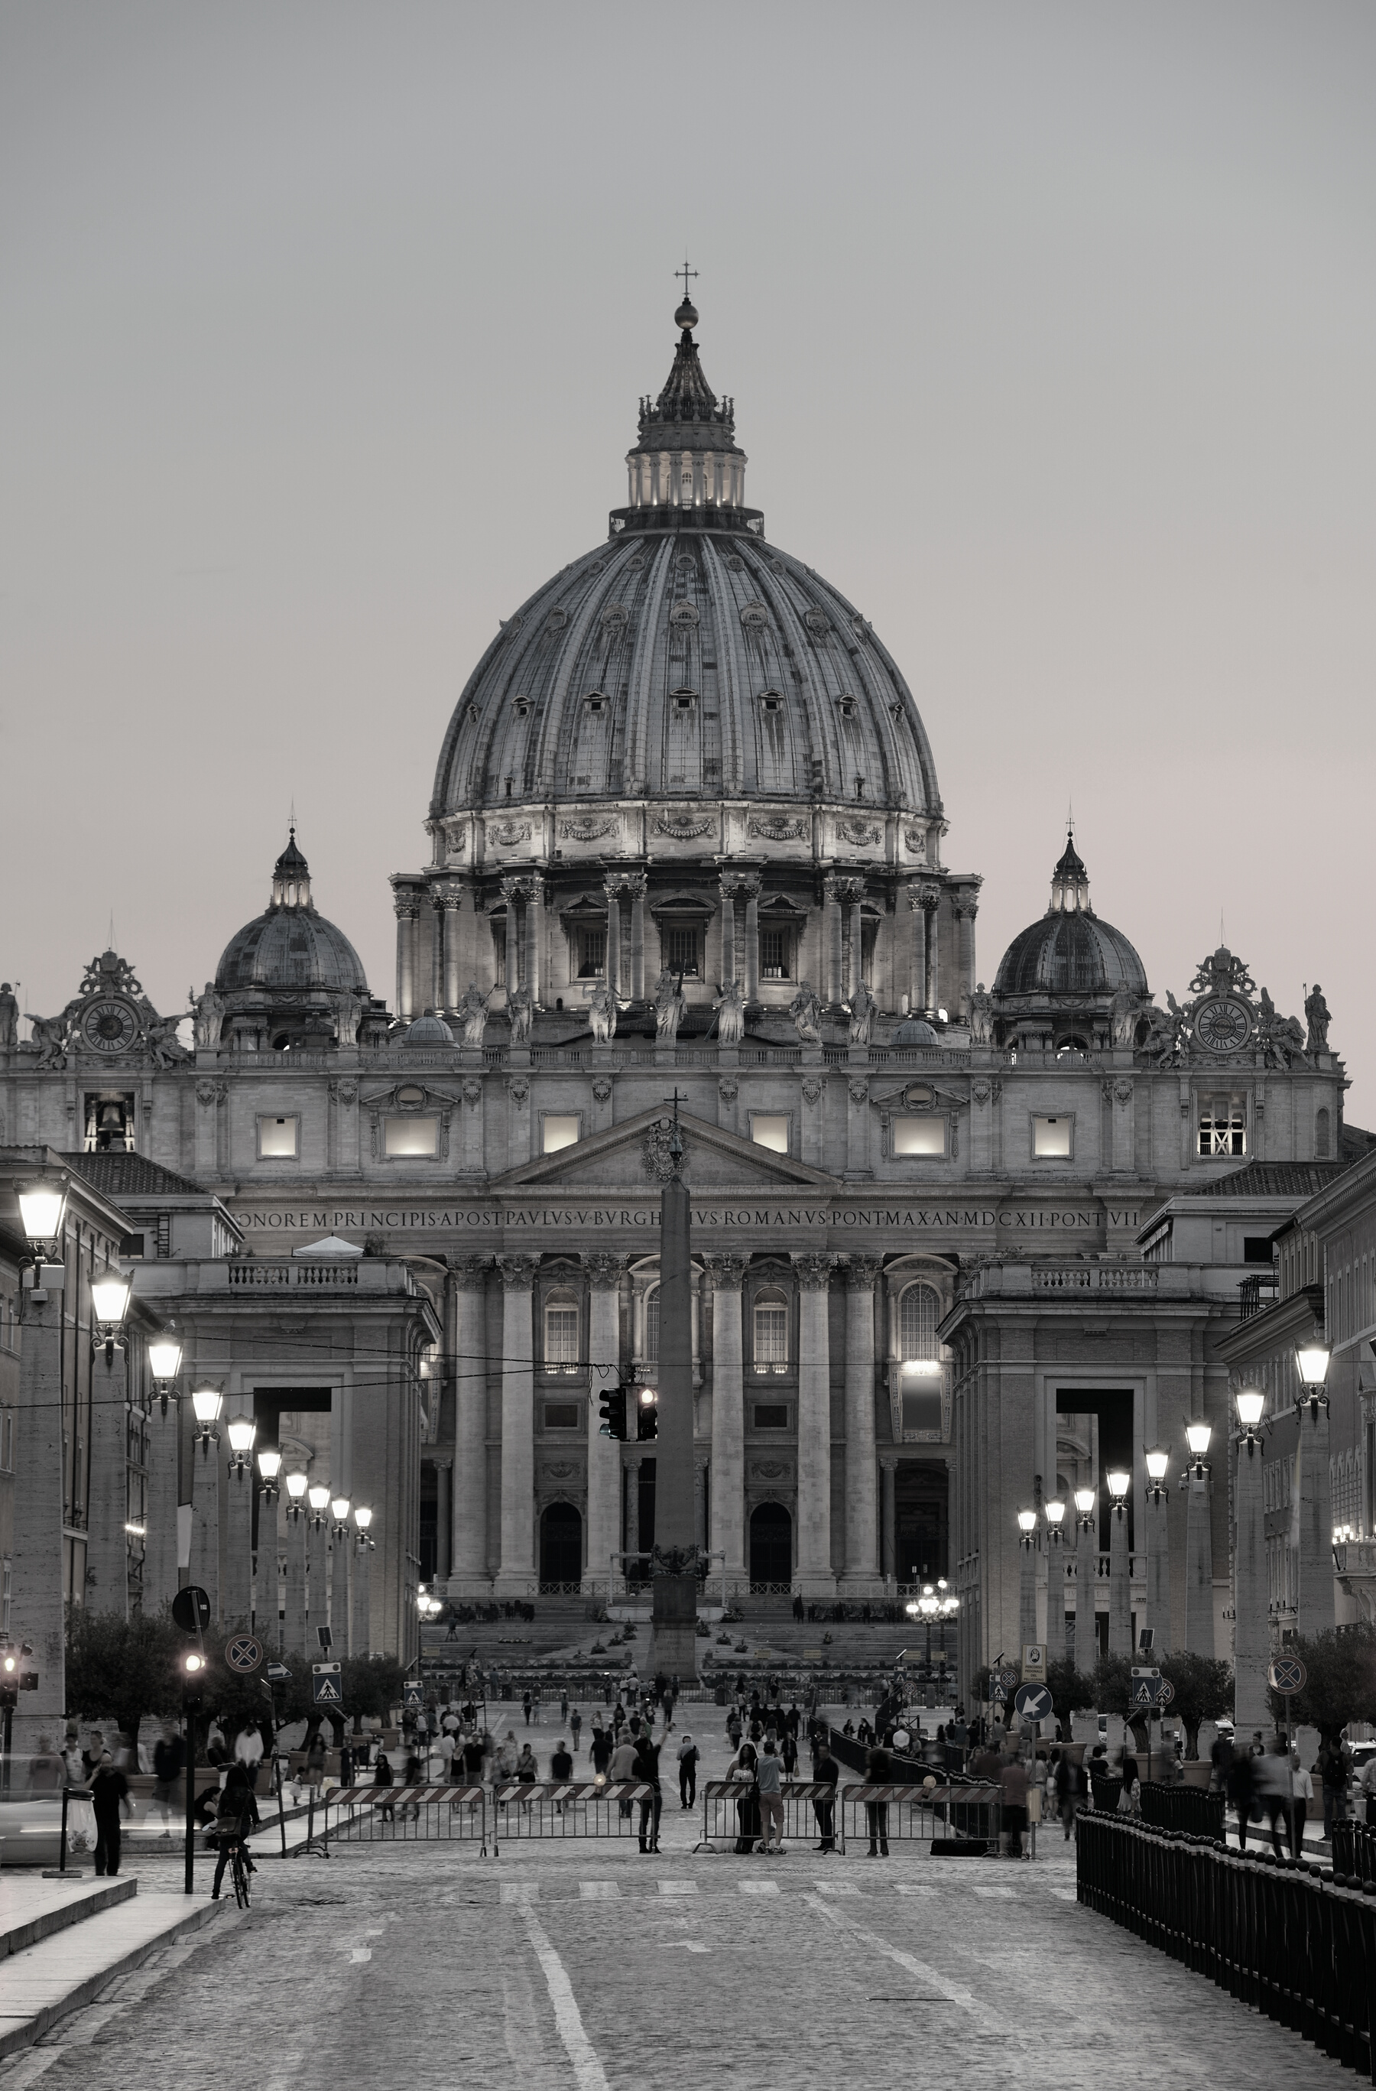


16th General Congregation
Introduction to the last working week #Synod2023
#Synod2023

Slide 2


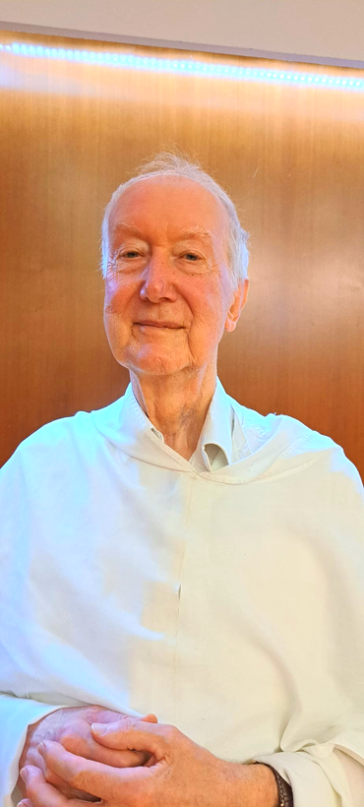
The synodal process is organic and ecological rather than competitive. It is more like planting a tree than winning a battle, and as such will be hard for many to understand, sometimes including ourselves!
Fr. Timothy P. Radcliffe, O.P.
Spiritual Assistant
#Synod2023

Slide 3
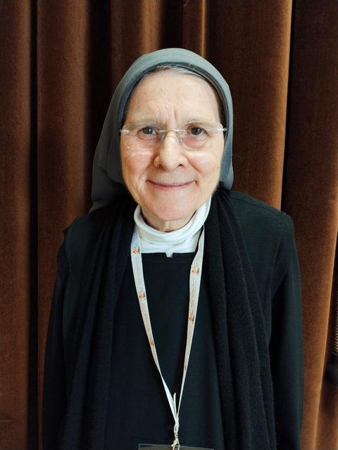
Today - in a culture of striving for supremacy, profit and followers, or evasion - the patient sowing of this synod is, in itself, like a profoundly subversive and revolutionary act.
Rev. Maria Grazia Angelini O.S.B.
Spiritual Assistant
#Synod2023

Slide 4
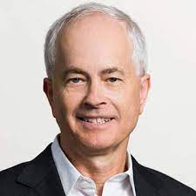
This Synod is a dialogue with God. That has been the privilege and challenge of your “conversations in the Spirit.” God is waiting for your reply.
Fr. Ormond Rush
Theological expert
#Synod2023

Slide 5





PRAY FOR THE
SYNOD
www.synod.va

Slide 6
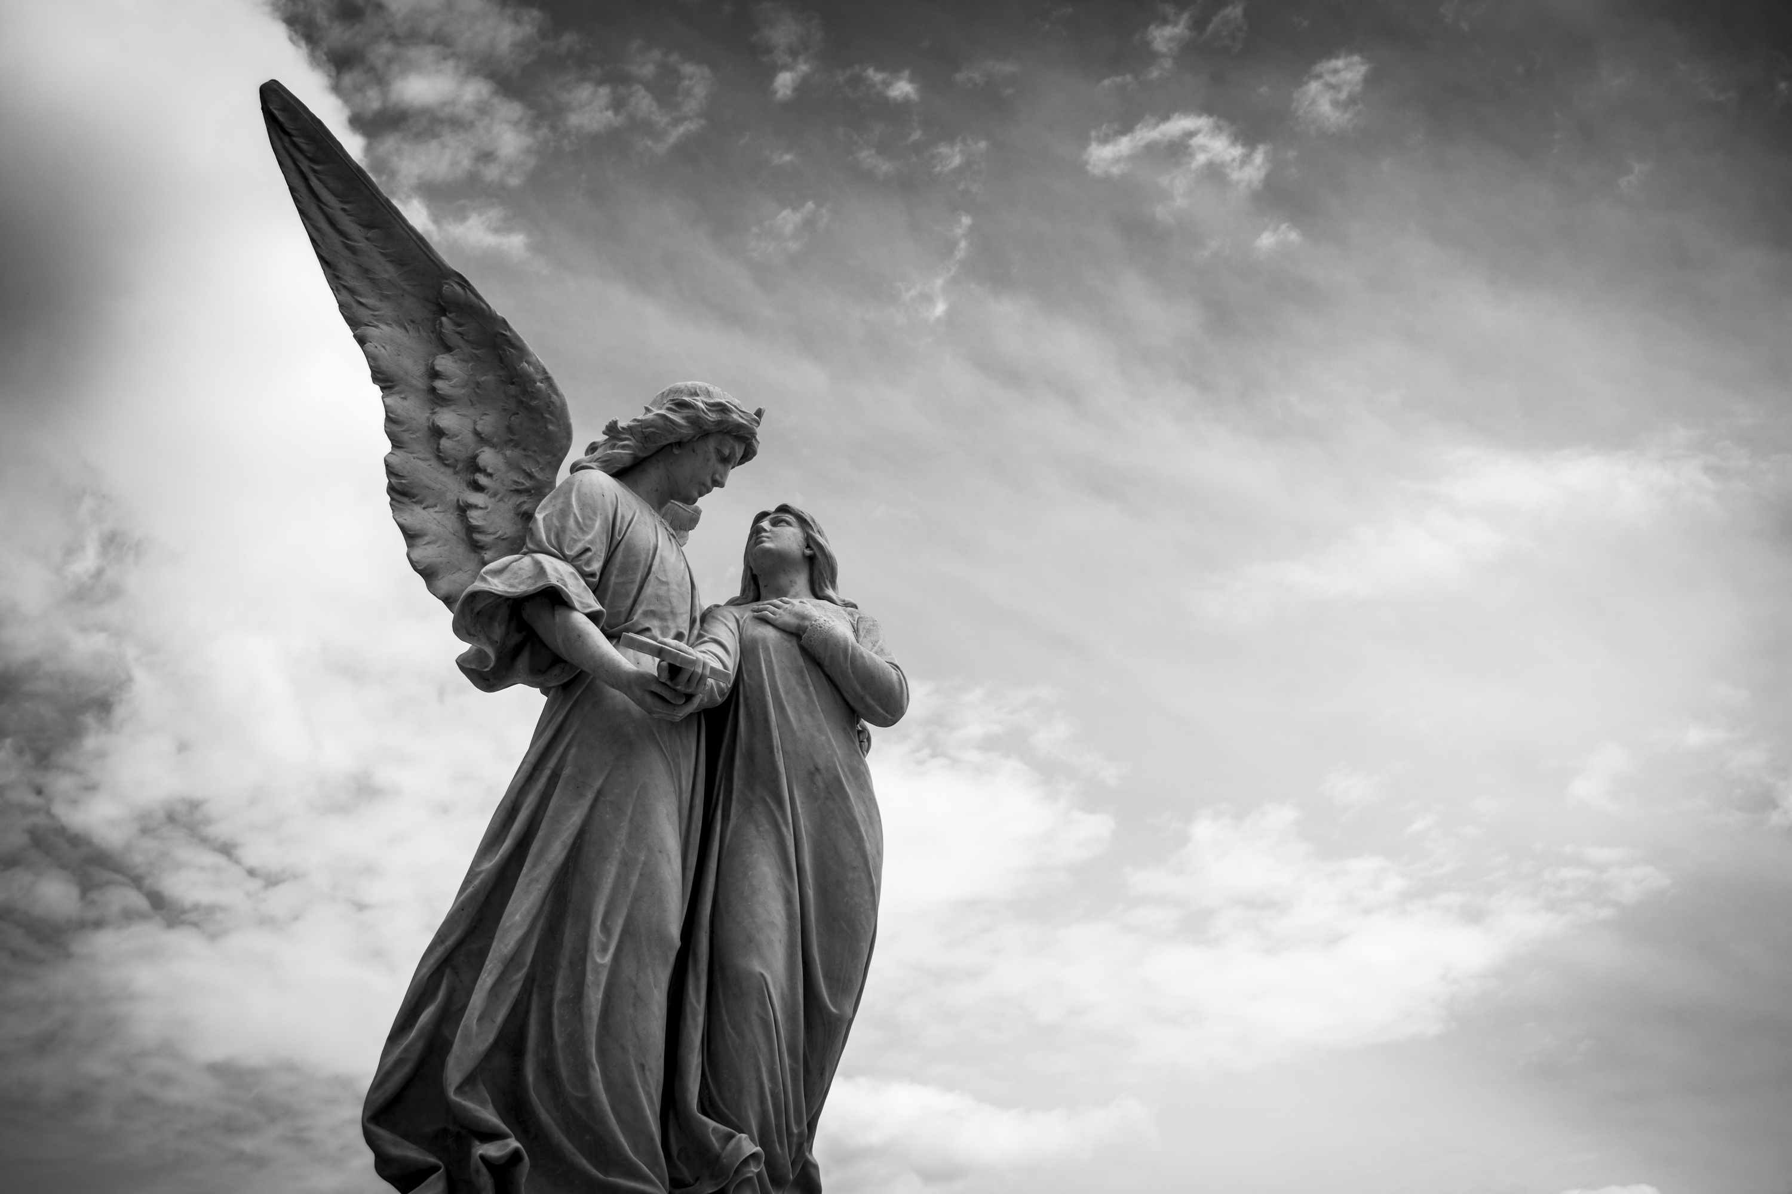

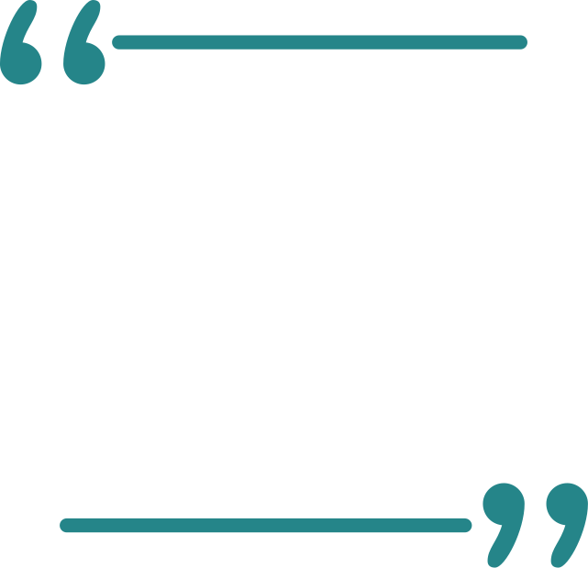

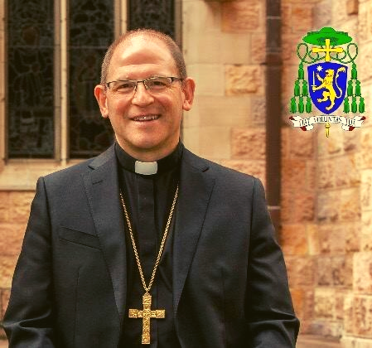
THE EXHORTATION OF JESUS IN THE GOSPEL TODAY REMINDS US THAT CHILDLIKE FAITH IS THE KEY TO THE KINGDOM OF HEAVEN.
Bishop Anthony Randazzo
Homily in the Holy Mass on 02/10/23
Retreat for the members of 16th Ordinary General Assembly of the Synod of Bishops

Slide 7


This morning the Word placed on our lips to become our Word, is in particular Psalm 117 (118) - the 'beautiful Confitemini', as Martin Luther calls it. Celebrating it in an assembly like this is disruptive, charged with meaning.
Rev. P. Timothy Peter Joseph Radcliffe, O.P.

Slide 8
Surprising, inspiring, is first of all the fact that the voice of the individual and of the assembly alternate in this song: as if to say that the experience of faith - as the story of the father Abraham illustrates (Gen 12:1-3) - is personal, but aimed at the convocation of the many. But the generative 'I' of the 'we' passes through death pains, it is the 'discarded stone' who opens the synodal procession.
Rev. P. Timothy Peter Joseph Radcliffe, O.P.

Slide 9





PRAY FOR THE
SYNOD
CONOCE MÁS
Mas información en:
www.synod.va

Slide 10
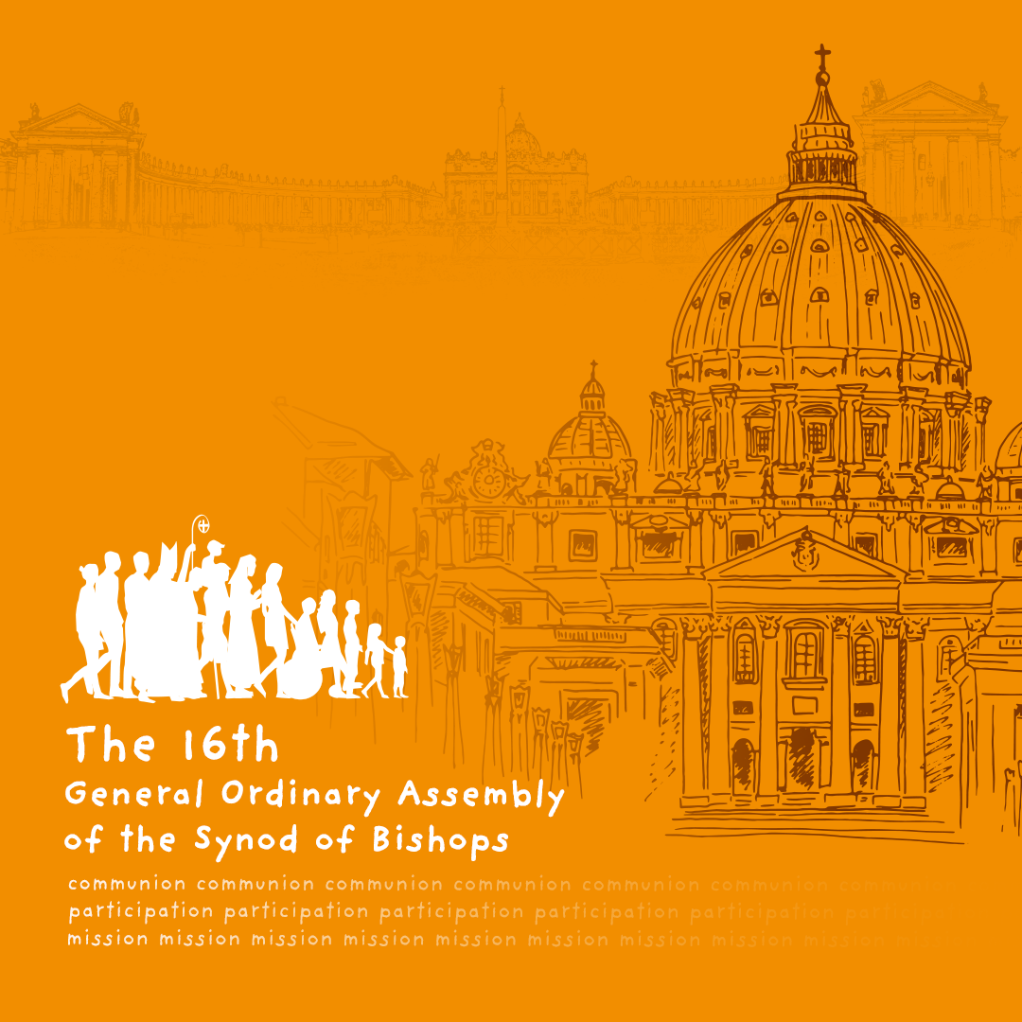
For a Synodal Church:
communion | participation | mission

