Slide 1




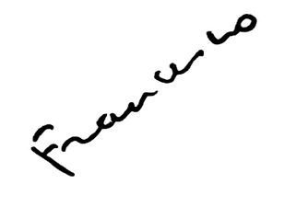



#Synod2023
18th General Congregation
Intervention
Pope Francis
Intervention at the
16th Ordinary General Assembly of the Synod of Bishops

Slide 2
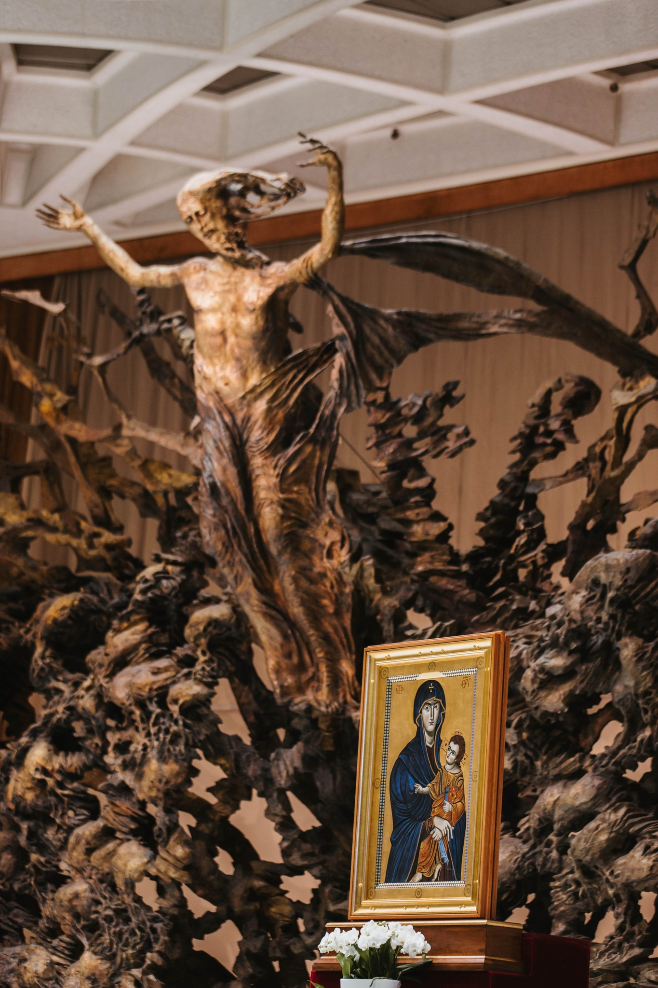
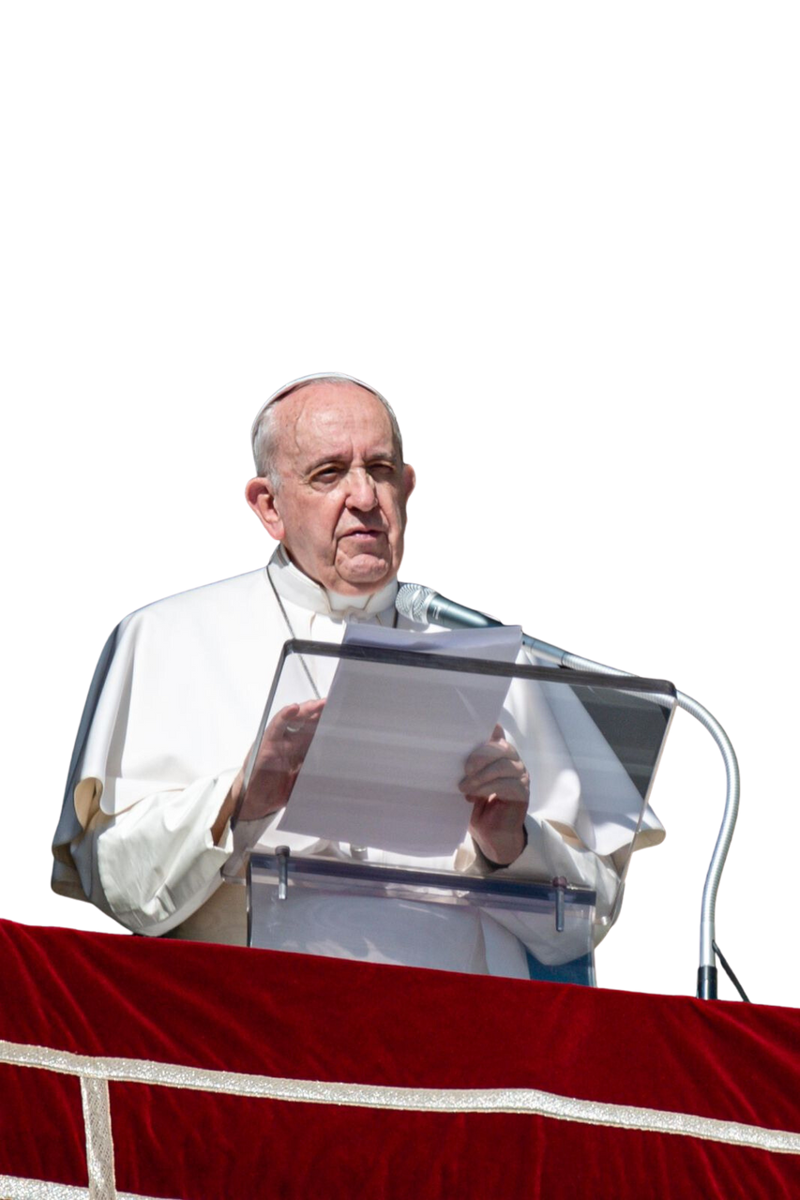
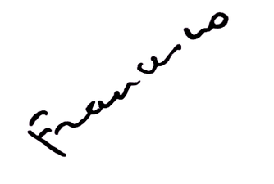
#Synod2023
"I like to think of the Church as God's faithful people, saint and sinner, a people convoked and called with the force of the beatitudes and of Matthew 25."

Slide 3
#Synod2023
"I like to think of the Church as this simple and humble people who walk in the presence of the Lord (the faithful people of God)."

Slide 4
#Synod2023
"Our faithful people are conscious of their dignity, they baptize their children, they bury their dead."

Slide 5
#Synod2023
"And here I like to underline that, among God's holy and faithful people, the faith is transmitted in dialect"

Slide 6
#Synod2023
"it is women who know how to wait, who know how to discover the resources of the Church, of the faithful people, who risk beyond the limit, perhaps with fear but courageous, and in the light and shade of a day that is beginning, they approach a tomb with the intuition (not yet hope) that there may be some life."

Slide 7
#Synod2023
"When ministers go too far in their service and mistreat the people of God, they disfigure the face of the Church with macho and dictatorial
attitudes"

Slide 8
#Synod2023
"It is painful to find in some parish offices the “price list” of sacramental services in the manner of a supermarket. Either the Church is the faithful people of God on the way, saint and sinner, or it ends up being
a company of various services."

Slide 9
#Synod2023
"Clericalism is a whip, it is a scourge, it is a form of worldliness that defiles and damages the face of the Lord’s bride; it enslaves God's holy and faithful people."

Slide 10
#Synod2023
"And God's people, God's holy faithful people, go forward with patience and humility, enduring the scorn, mistreatment, and marginalization of institutionalized clericalism."

Slide 11

#Synod2023
PRAY FOR THE
SYNOD

