Slide 1
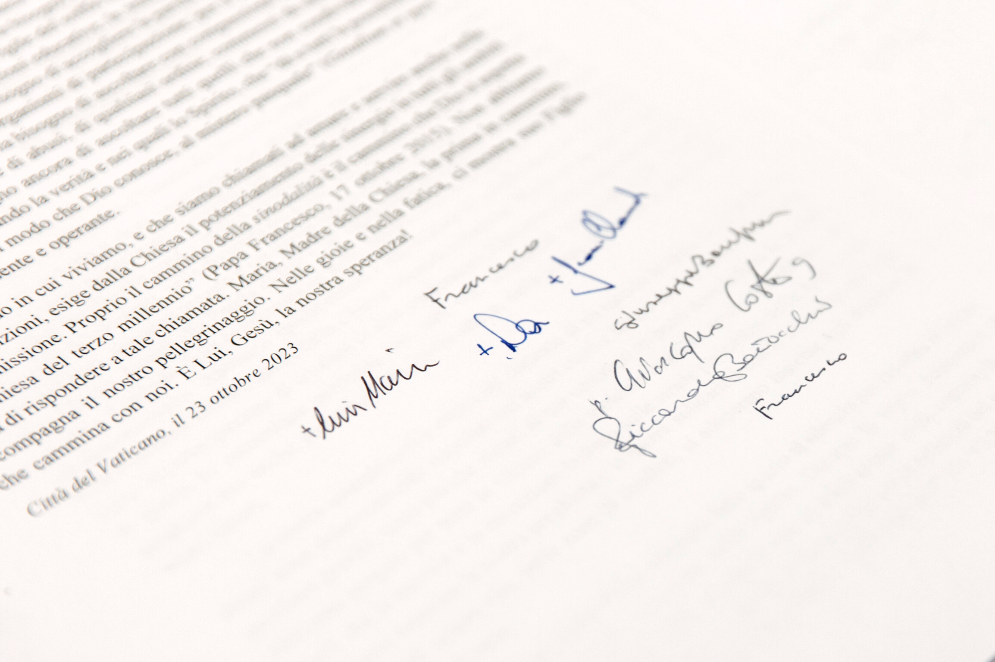



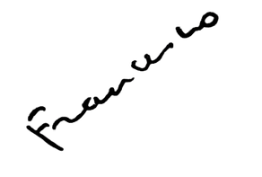



#Synod2023
Letter
to the people of God
16th Ordinary General Assembly of the Synod of Bishops

Slide 2


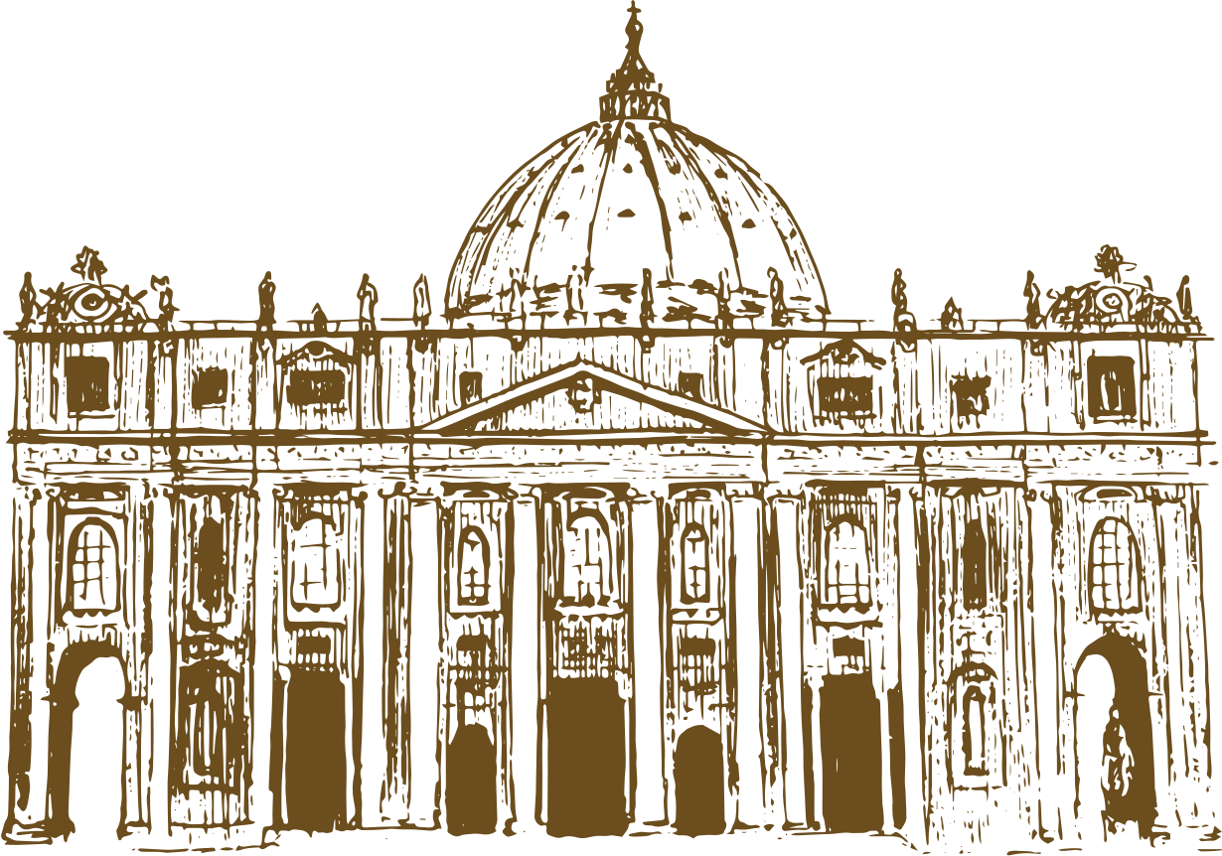


#Synod2023
Letter to the to the people of God
"We lived this blessed time in profound communion with all of you. We were supported by your prayers, bearing with you your expectations, your questions, as well as your fears."

Slide 3
#Synod2023
Letter to the to the people of God
“Using the conversation in the Spirit method, we have humbly shared the wealth and poverty of our communities from every continent, seeking to discern what the Holy Spirit wants to say to the Church today."

Slide 4
#Synod2023
Letter to the to the people of God
“Our assembly took place in the context of a world in crisis, whose wounds and scandalous inequalities resonated painfully in our hearts, infusing our work with a particular gravity, especially since some of us come from countries where war rages."

Slide 5
#Synod2023
Letter to the to the people of God
"Firmly united in the hope brought by His Resurrection, we entrusted to Him our common home where the cries of the earth and the poor are becoming increasingly urgent: “Laudate Deum!” (“Praise God!”), as Pope Francis reminded us at the beginning of our work."

Slide 6
#Synod2023
Letter to the to the people of God
"It is “trust” that gives us the audacity and inner freedom that we experienced, not hesitating to freely and humbly express our convergences, differences, desires and questions."

Slide 7
#Synod2023
Letter to the to the people of God
"We hope that the months leading to the second session in October 2024 will allow everyone to concretely participate in the dynamism of missionary communion indicated by the word "synod". This is not about ideology, but about an experience rooted in the apostolic tradition."

Slide 8
#Synod2023
Letter to the to the people of God
"Above all, the Church of our time has the duty to listen, in a spirit of conversion, to those who have been victims of abuse committed by members of the ecclesial body, and to commit herself concretely and structurally to ensuring that this does not happen again."

Slide 9
#Synod2023
Letter to the to the people of God
"We do not need to be afraid to respond to this call. Mary, Mother of the Church, the first on the journey, accompanies our pilgrimage. In joy and in sorrow, she shows us her Son and invites us to trust. And He, Jesus, is our only hope!”

Slide 10


PRAY FOR THE
SYNOD

